Slide 1

DIVINE GRACE COLLEGE OF ARTS, SCIENCE AND TECHNOLOGY
(DGCAST) — GAROUA | GEOGRAPHY DEPARTMENT
UPPER SIXTH ARTS — ECONOMIC GEOGRAPHY — LESSON 1
Natural Resources
Mr KAMDEM EMMANUEL
Geography Teacher — PLEG
Academic Year 2026 / 2027
Notes:
Good morning, class. Today we study Lesson 1: Natural Resources.

Slide 2
GEOGRAPHY — UPPER SIXTH ARTS
CLASS INFO
Class, Chapter & Duration
Class | Upper Sixth Arts
Chapter | Module 6: Understanding and managing the dynamics of economic activities across the world in general and Cameroon in particular
Duration | 2 periods (2 × 50 minutes)
2026 / 2027
DGCAST GAROUA — GEOGRAPHY DEPARTMENT
Mr KAMDEM E. | 2

Slide 3
GEOGRAPHY — UPPER SIXTH ARTS
IDENTIFICATION
Lesson Identification
Topic | Resources and Economic Activities
Sub-topic | Resources and Economic Activities
Lesson | Lesson 1: Natural Resources
Notions / Concepts | Resource, natural resource, renewable, non-renewable, resource use, technology.
Syllabus focus | Meaning; classification into renewable and non-renewable resources; spatial variations in resource use and its factors (culture, population size, technology).
Competence | Learners are able to classify natural resources and explain why their use varies from place to place.
2026 / 2027
DGCAST GAROUA — GEOGRAPHY DEPARTMENT
Mr KAMDEM E. | 3

Slide 4
GEOGRAPHY — UPPER SIXTH ARTS
OBJECTIVES
Learning Objectives
By the end of the lesson, the learner should be able to:
Define a natural resource.
Classify resources into renewable and non-renewable.
Explain the factors of resource use.
2026 / 2027
DGCAST GAROUA — GEOGRAPHY DEPARTMENT
Mr KAMDEM E. | 4

Slide 5
GEOGRAPHY — UPPER SIXTH ARTS
RECALL
Recall
People depend on land, water and forests.
Minerals and oil are found underground.
2026 / 2027
DGCAST GAROUA — GEOGRAPHY DEPARTMENT
Mr KAMDEM E. | 5

Slide 6
GEOGRAPHY — UPPER SIXTH ARTS
REAL-LIFE SITUATION
Real-Life Situation
Cameroon has large forests, rivers, oil, bauxite and fertile soils, yet many of these resources are little used. Japan has few natural resources but is one of the richest countries in the world.
2026 / 2027
DGCAST GAROUA — GEOGRAPHY DEPARTMENT
Mr KAMDEM E. | 6
Notes:
Read the situation slowly, twice.

Slide 7
GEOGRAPHY — UPPER SIXTH ARTS
REAL-LIFE SITUATION
Situation — Question 1
What is the problem in the situation?
2026 / 2027
DGCAST GAROUA — GEOGRAPHY DEPARTMENT
Mr KAMDEM E. | 7

Slide 8
GEOGRAPHY — UPPER SIXTH ARTS
REAL-LIFE SITUATION
Answer
Having resources does not always mean using them.
2026 / 2027
DGCAST GAROUA — GEOGRAPHY DEPARTMENT
Mr KAMDEM E. | 8

Slide 9
GEOGRAPHY — UPPER SIXTH ARTS
REAL-LIFE SITUATION
Situation — Question 2
Why does Japan use resources well?
2026 / 2027
DGCAST GAROUA — GEOGRAPHY DEPARTMENT
Mr KAMDEM E. | 9

Slide 10
GEOGRAPHY — UPPER SIXTH ARTS
REAL-LIFE SITUATION
Answer
It has high technology, skills and capital.
2026 / 2027
DGCAST GAROUA — GEOGRAPHY DEPARTMENT
Mr KAMDEM E. | 10

Slide 11
GEOGRAPHY — UPPER SIXTH ARTS
REAL-LIFE SITUATION
Situation — Question 3
Which resources of Cameroon are non-renewable?
2026 / 2027
DGCAST GAROUA — GEOGRAPHY DEPARTMENT
Mr KAMDEM E. | 11

Slide 12
GEOGRAPHY — UPPER SIXTH ARTS
REAL-LIFE SITUATION
Possible Answer
Oil, bauxite, iron ore, gold.
2026 / 2027
DGCAST GAROUA — GEOGRAPHY DEPARTMENT
Mr KAMDEM E. | 12

Slide 13
GEOGRAPHY — UPPER SIXTH ARTS
JUSTIFICATION
Justification of the Lesson
This lesson introduces economic geography: how people use the resources of the Earth.
2026 / 2027
DGCAST GAROUA — GEOGRAPHY DEPARTMENT
Mr KAMDEM E. | 13

Slide 14

GEOGRAPHY — UPPER SIXTH ARTS
I. MEANING
Activity 1
The forest, a natural resource.
2026 / 2027
DGCAST GAROUA — GEOGRAPHY DEPARTMENT
Mr KAMDEM E. | 14
Notes:
Without the projector: list resources of your region.

Slide 15
GEOGRAPHY — UPPER SIXTH ARTS
I. MEANING
Activity 1: Question
What is a natural resource?
2026 / 2027
DGCAST GAROUA — GEOGRAPHY DEPARTMENT
Mr KAMDEM E. | 15

Slide 16
GEOGRAPHY — UPPER SIXTH ARTS
I. MEANING
Answer
Anything from nature that people can use, such as land, water, forests or minerals.
2026 / 2027
DGCAST GAROUA — GEOGRAPHY DEPARTMENT
Mr KAMDEM E. | 16

Slide 17
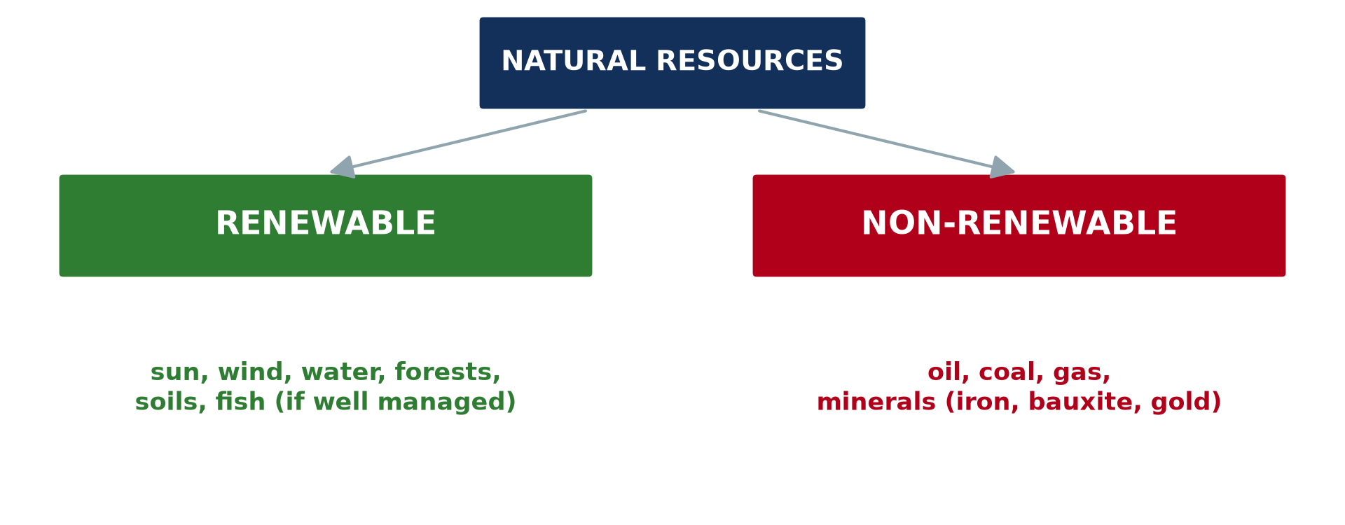
GEOGRAPHY — UPPER SIXTH ARTS
II. CLASSIFICATION
Activity 2
Renewable and non-renewable resources.
2026 / 2027
DGCAST GAROUA — GEOGRAPHY DEPARTMENT
Mr KAMDEM E. | 17
Notes:
Without the projector: sort resources into two lists.

Slide 18
GEOGRAPHY — UPPER SIXTH ARTS
II. CLASSIFICATION
Activity 2: Question
Distinguish renewable and non-renewable resources.
2026 / 2027
DGCAST GAROUA — GEOGRAPHY DEPARTMENT
Mr KAMDEM E. | 18

Slide 19
GEOGRAPHY — UPPER SIXTH ARTS
II. CLASSIFICATION
Answer
Renewable resources can be replaced naturally; non-renewable resources are used up.
2026 / 2027
DGCAST GAROUA — GEOGRAPHY DEPARTMENT
Mr KAMDEM E. | 19

Slide 20
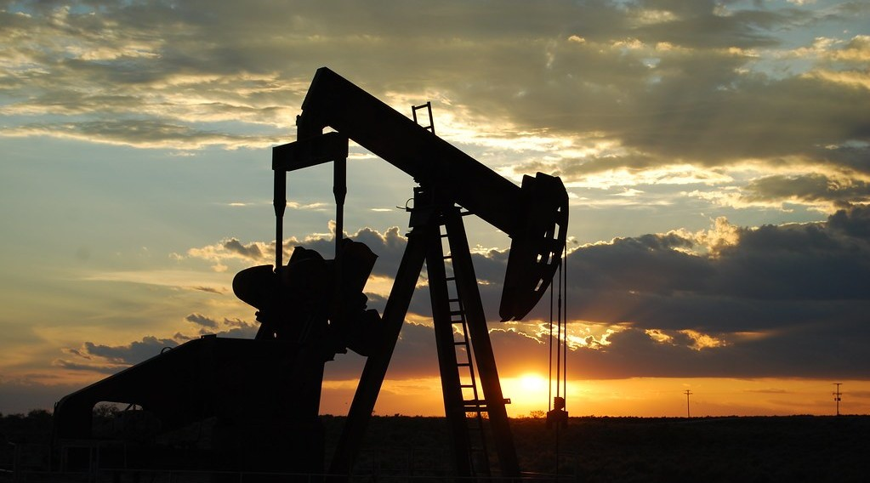
GEOGRAPHY — UPPER SIXTH ARTS
II. CLASSIFICATION
Activity 3
An oil pump.
2026 / 2027
DGCAST GAROUA — GEOGRAPHY DEPARTMENT
Mr KAMDEM E. | 20
Notes:
Without the projector: mention oil fields of Cameroon.

Slide 21
GEOGRAPHY — UPPER SIXTH ARTS
II. CLASSIFICATION
Activity 3: Question
Why is oil called non-renewable?
2026 / 2027
DGCAST GAROUA — GEOGRAPHY DEPARTMENT
Mr KAMDEM E. | 21

Slide 22
GEOGRAPHY — UPPER SIXTH ARTS
II. CLASSIFICATION
Answer
It took millions of years to form and cannot be replaced once used.
2026 / 2027
DGCAST GAROUA — GEOGRAPHY DEPARTMENT
Mr KAMDEM E. | 22

Slide 23
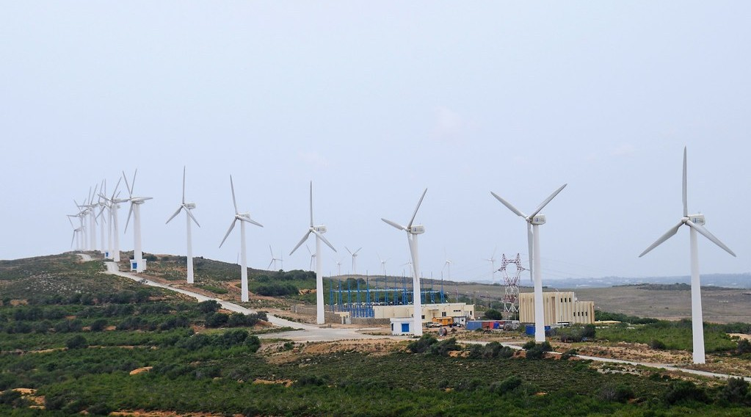
GEOGRAPHY — UPPER SIXTH ARTS
III. FACTORS OF USE
Activity 4
Wind turbines.
2026 / 2027
DGCAST GAROUA — GEOGRAPHY DEPARTMENT
Mr KAMDEM E. | 23
Notes:
Without the projector: discuss solar panels.

Slide 24
GEOGRAPHY — UPPER SIXTH ARTS
III. FACTORS OF USE
Activity 4: Question
How does technology change what is a resource?
2026 / 2027
DGCAST GAROUA — GEOGRAPHY DEPARTMENT
Mr KAMDEM E. | 24

Slide 25
GEOGRAPHY — UPPER SIXTH ARTS
III. FACTORS OF USE
Answer
New technology lets people use things that were useless before, like wind.
2026 / 2027
DGCAST GAROUA — GEOGRAPHY DEPARTMENT
Mr KAMDEM E. | 25

Slide 26

GEOGRAPHY — UPPER SIXTH ARTS
III. FACTORS OF USE
Activity 5
A crowded market.
2026 / 2027
DGCAST GAROUA — GEOGRAPHY DEPARTMENT
Mr KAMDEM E. | 26
Notes:
Without the projector: list factors.

Slide 27
GEOGRAPHY — UPPER SIXTH ARTS
III. FACTORS OF USE
Activity 5: Question
Give two other factors of resource use.
2026 / 2027
DGCAST GAROUA — GEOGRAPHY DEPARTMENT
Mr KAMDEM E. | 27

Slide 28
GEOGRAPHY — UPPER SIXTH ARTS
III. FACTORS OF USE
Answer
Population size and culture (also capital and government policy).
2026 / 2027
DGCAST GAROUA — GEOGRAPHY DEPARTMENT
Mr KAMDEM E. | 28

Slide 29
GEOGRAPHY — UPPER SIXTH ARTS
BOARD SUMMARY
Natural Resources
Topic: Resources and Economic Activities
Sub-topic: Resources and Economic Activities
Lesson 1: Natural Resources
2026 / 2027
DGCAST GAROUA — GEOGRAPHY DEPARTMENT
Mr KAMDEM E. | 29
Notes:
Learners copy the board summary now. Give them enough time for each slide.

Slide 30
GEOGRAPHY — UPPER SIXTH ARTS
BOARD SUMMARY
I. Definitions
Natural resource: It is anything from nature that people can use to meet their needs.
Renewable resource: It is a resource that can be replaced naturally, like water or forests.
Non-renewable resource: It is a resource that is used up and cannot be replaced, like oil.
2026 / 2027
DGCAST GAROUA — GEOGRAPHY DEPARTMENT
Mr KAMDEM E. | 30

Slide 31
GEOGRAPHY — UPPER SIXTH ARTS
BOARD SUMMARY
II. Classification (1/2)
A. Renewable resources: Sun, wind, water, soils, forests and fish can be renewed. They must be managed well to last.
B. Non-renewable resources: Oil, coal, gas and minerals took millions of years to form. They will run out.
2026 / 2027
DGCAST GAROUA — GEOGRAPHY DEPARTMENT
Mr KAMDEM E. | 31

Slide 32
GEOGRAPHY — UPPER SIXTH ARTS
BOARD SUMMARY
II. Classification (2/2)
C. Other groups: Resources can also be biotic (living) or abiotic (non-living). They can be actual (used) or potential (not yet used).
2026 / 2027
DGCAST GAROUA — GEOGRAPHY DEPARTMENT
Mr KAMDEM E. | 32

Slide 33
GEOGRAPHY — UPPER SIXTH ARTS
BOARD SUMMARY
III. Spatial Variations and Factors (1/3)
A. Variations: Rich countries use most of the world's resources. Many poor countries export raw resources without using them.
B. Technology and capital: Skills, machines and money allow the use of resources. Japan uses imported resources very well.
2026 / 2027
DGCAST GAROUA — GEOGRAPHY DEPARTMENT
Mr KAMDEM E. | 33

Slide 34
GEOGRAPHY — UPPER SIXTH ARTS
BOARD SUMMARY
III. Spatial Variations and Factors (2/3)
C. Population and culture: Large populations need more resources. Culture decides what people eat, wear and use.
2026 / 2027
DGCAST GAROUA — GEOGRAPHY DEPARTMENT
Mr KAMDEM E. | 34

Slide 35
GEOGRAPHY — UPPER SIXTH ARTS
BOARD SUMMARY
III. Spatial Variations and Factors (3/3)
Copy the classification.
2026 / 2027
DGCAST GAROUA — GEOGRAPHY DEPARTMENT
Mr KAMDEM E. | 35

Slide 36
GEOGRAPHY — UPPER SIXTH ARTS
FORMATIVE EVALUATION
Formative Evaluation 1
Distinguish renewable and non-renewable resources with examples.
2026 / 2027
DGCAST GAROUA — GEOGRAPHY DEPARTMENT
Mr KAMDEM E. | 36

Slide 37
GEOGRAPHY — UPPER SIXTH ARTS
FORMATIVE EVALUATION
Expected Answer
Renewable: replaced naturally (forests, water). Non-renewable: used up (oil, bauxite).
2026 / 2027
DGCAST GAROUA — GEOGRAPHY DEPARTMENT
Mr KAMDEM E. | 37

Slide 38
GEOGRAPHY — UPPER SIXTH ARTS
FORMATIVE EVALUATION
Formative Evaluation 2
Give two factors of resource use.
2026 / 2027
DGCAST GAROUA — GEOGRAPHY DEPARTMENT
Mr KAMDEM E. | 38

Slide 39
GEOGRAPHY — UPPER SIXTH ARTS
FORMATIVE EVALUATION
Expected Answer
Technology and population size (also culture, capital).
2026 / 2027
DGCAST GAROUA — GEOGRAPHY DEPARTMENT
Mr KAMDEM E. | 39

Slide 40
GEOGRAPHY — UPPER SIXTH ARTS
REMEDIATION
Remediation
Fill in the blanks:
Resources that can be replaced are ______.
Oil is a ______ resource.
New ______ makes new things become resources.
2026 / 2027
DGCAST GAROUA — GEOGRAPHY DEPARTMENT
Mr KAMDEM E. | 40
Notes:
Answers: 1. renewable 2. non-renewable 3. technology

Slide 41
GEOGRAPHY — UPPER SIXTH ARTS
HOMEWORK
Homework
List five resources of your region and say whether each is renewable or not.
This prepares Lesson 2: What is Agriculture?
2026 / 2027
DGCAST GAROUA — GEOGRAPHY DEPARTMENT
Mr KAMDEM E. | 41
Notes:
This homework prepares the next lesson.

Slide 42
GEOGRAPHY — UPPER SIXTH ARTS
BILINGUAL GAME
Bilingual Game (Jeu Bilingue)
English | Français
Resource | La ressource
Renewable | Renouvelable
Non-renewable | Non renouvelable
Technology | La technologie
Capital | Le capital
Use | L'exploitation
2026 / 2027
DGCAST GAROUA — GEOGRAPHY DEPARTMENT
Mr KAMDEM E. | 42
Notes:
Say the English word; learners give the French word, then the reverse.

Slide 43
GEOGRAPHY — UPPER SIXTH ARTS
LOGBOOK
Official Logbook (1/2)
Module / Topic | Resources and Economic Activities
Lesson Title | Lesson 1: Natural Resources
Expected Learning Outcomes | Define a natural resource. Classify resources into renewable and non-renewable. Explain the factors of resource use.
Competence | Learners are able to classify natural resources and explain why their use varies from place to place.
2026 / 2027
DGCAST GAROUA — GEOGRAPHY DEPARTMENT
Mr KAMDEM E. | 43

Slide 44
GEOGRAPHY — UPPER SIXTH ARTS
LOGBOOK
Official Logbook (2/2)
Matter Taught | I. Definitions: Natural resource, Renewable resource, Non-renewable resource; II. Classification: Renewable resources, Non-renewable resources, Other groups; III. Spatial Variations and Factors: Variations, Technology and capital, Population and culture.
Evaluation | Formative evaluation (3 questions) and remediation exercise.
Homework | List five resources of your region and say whether each is renewable or not.
Enrolment / Present / Absent | ____ / ____ / ____
Achievement | To be completed by the teacher after the lesson.
2026 / 2027
DGCAST GAROUA — GEOGRAPHY DEPARTMENT
Mr KAMDEM E. | 44

Slide 45
GEOGRAPHY — UPPER SIXTH ARTS
TEACHER'S NOTE
Teacher's Note
Timing: Set-up, recall 8 min | Situation 8 min | 5 activities 30 min | Board summary (copying) 30 min | Evaluation, remediation 10 min | Homework, logbook 9 min | Spare 5 min
2026 / 2027
DGCAST GAROUA — GEOGRAPHY DEPARTMENT
Mr KAMDEM E. | 45

Slide 46
GEOGRAPHY — UPPER SIXTH ARTS
REFERENCES
References
National Geography Syllabus, Sixth Forms (Lower & Upper Sixth), MINESEC/IGE/IP-SS, August 2019 — Module 6 (Economic Geography).
Photo, Activity 1: “Amazon 11” by CIAT International Center for Tropical Agriculture, CC BY-SA 2.0, via Flickr (https://www.flickr.com/photos/38476503@N08/5641587148)
Photo, Activity 3: “Oil Pump Jack” by Paul Lowry, CC BY 2.0, via Flickr (https://www.flickr.com/photos/10039026@N03/2770193028)
Photo, Activity 4: “Wind turbine farm” by World Bank Photo Collection, CC BY-NC-ND 2.0, via Flickr (https://www.flickr.com/photos/10816734@N03/4941489845)
Photo, Activity 5: “Wax market” by zouzouwizman, CC BY 2.0, via Flickr (https://www.flickr.com/photos/61111202@N00/12129001)
Diagrams and animations: drawn for this lesson (DGCAST Geography Department).
2026 / 2027
DGCAST GAROUA — GEOGRAPHY DEPARTMENT
Mr KAMDEM E. | 46

